Slide 1

How does the future look?
Navigating changes in the private rented sector
ALANA DAVIES
Regional Engagement Executive
T: 0161 515 3792
M: 07943 722299
E: alana.davies@nrla.gov.uk
W: www.nrla.co.uk

Slide 2
The Renters Right Act
Be prepared, change is coming

Slide 3

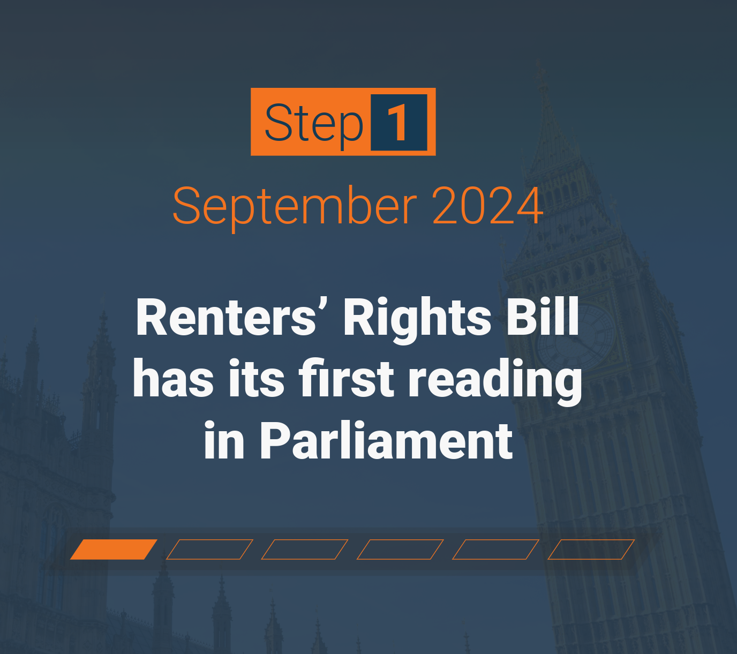


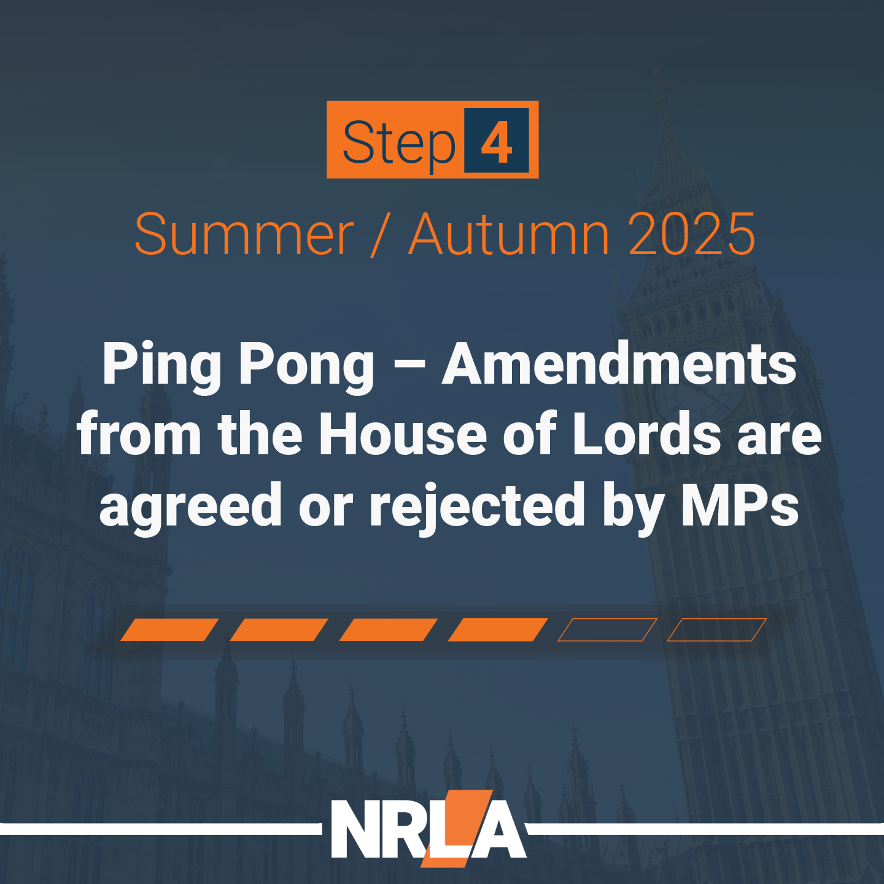
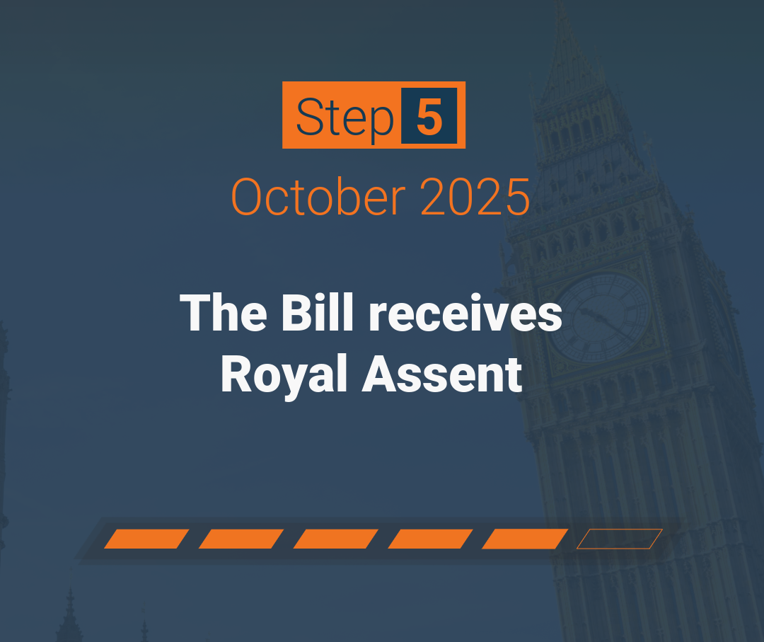
Where we are now:
www.nrla.org.uk

Slide 4

Tenancy reform
Periodic assured tenancies
Rental periods limited to no more than one month.
No rent can be required before agreeing tenancy; rent in advance restricted after that (except existing tenancies).
Tenants can give two months’ notice at any time.
Written statement
Key terms to be given in writing before the tenancy begins, usually as part of a wider tenancy agreement.
NRLA draft periodic tenancies available on the website now
Rent increases
Rent can be increased once per year via Section 13 process.
The tenant can currently challenge this for free, delaying the rent increase until the Tribunal has decided on a new rent level.
A £47 fee to make the appeal has been announced but is not in effect yet and there is no date set.

Slide 5
Advertising and discrimination
Banning bidding wars
Must list asking rent on any adverts and offers.
Banned from encouraging or accepting rents above this.
Fines of up to £7,000 for breaches.
Preventing discrimination
Bans discrimination against tenants in receipt of benefits, or with children, including when:
  Enquiring about or seeking information on the property.
  Attending viewings.
  Entering into a tenancy.
Pets in properties
Right to request a pet for tenants. Can only be refused on reasonable grounds.

Slide 6
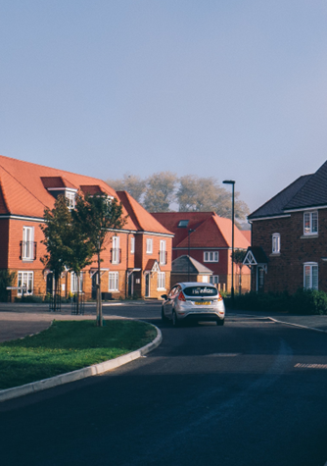
Ending a periodic tenancy
Abolition of Section 21.
New and amended Section 8 grounds including:
Grounds for sale or moving family in
    Require four months’ notice.
    Cannot relet, or try to relet, for (probably) more than a year after serving.
  An updated mandatory rent arrears ground
    Three months’ arrears and four weeks' notice.
    Any Universal Credit delays don’t count as arrears.
  A new student ground
    Only applies to student HMOs, June-September, where tenancy entered into less than six months before move-in.
New offence for recklessly or knowingly misusing a possession ground, fine of up to £7,000.
New civil penalty for illegal eviction or harassment, up to £40,000.

Slide 7

PRS Database and Ombudsman
Register on the database and sign up to the new Ombudsman, for a fee, before a property is let.
Database: Planned to be phased, regional roll out from end of 2026.
Ombudsman: Expected 2028.​
Testing
We are aware of some landlords and agents who are testing it who have spoken to us who are taking part in database testing and so far, it has primarily been testing functionality (registering, inputting information, uploading documents.)
Fees
Currently there is no clear indication of the costs of the database or ombudsman. The impact assessment estimated costs of £7 a year but this seems unlikely.
A likely educated guess would be comparable but slightly lesser than selective licensing costs as both selective licensing schemes and the databases’ fees are to cover the set up, administration, application and enforcement.
Rough estimate – around £700 for a selective licence for 5 years. Database will renew yearly instead but be comparable over the same time period.

Slide 8
Enforcement
New fines and powers
Local authority fines of up to £7,000 or £40,000 for a host of new offences, including:
  Not joining the database, offering a fixed term tenancy, misusing a possession ground, not giving a written statement, taking rent in advance and breaching the Decent Homes Standard.
Local authorities may also enter business and rented properties without a warrant or notice for certain offences.
Investigatory powers will be available two months after Royal Assent (i.e. ahead of the Bill coming into force).
Rent repayment orders
Rent repayment orders are to be expanded to cover two years instead of one and become available for a range of new offences.

Slide 9
Key dates: phase 1
27 December 2025
Local authorities gained new enforcement and investigatory powers.
March 2026
Publication of information sheet for existing tenants.
1 May 2026
Implementation of the first phase of the Renters’ Rights Act, including the loss of Section 21 and the abolition of fixed term assured shorthold tenancies.
January 2026
Publication of information that needs to be in tenancy agreements.
30 April 2026
Last day to serve a Section 21 notice or agree a tenancy that can take rent in advance.
31 May 2026
Last day to issue information sheet and intention to use Ground 4A to existing tenants

Slide 10
Key dates: phase 2
Spring/Summer 2026
Financial Penalties for Category 1 Hazards (following publication of updated guidance).
From late 2026
PRS database roll-out begins.
2028
Expected date for mandatory sign-up to the PRS Landlord Ombudsman.
31 July 2026
Deadline for applications to court for possession under Section 21.
April 2027
Government expects end-to-end digitisation of the courts.
www.nrla.org.uk

Slide 11
Existing Tenancies
What is an existing tenancy?
Any assured or assured shorthold tenancy signed by all parties before 1 May 2026. This includes tenancies with a move in date after 1 May 2026
What paperwork is needed for existing tenancies?
You do not need to provide a new agreement to convert to an assured periodic tenancy. It happens automatically.
Within a month of the commencement date, you need to provide one of the following:
  The Government's official Information Sheet for existing tenancies — if your tenancy is wholly or partially in writing
  A written statement setting out the key terms of your tenancy — if it is a wholly oral tenancy
You are able to serve this prior to 1 May 2026.
If you serve a valid notice before 1st May, then while a possession claim carries on this requirement is suspended - until a month after possession concludes, by which time you must have served the relevant docs.
What penalties are there?
Failure to provide the Information Sheet or written statement carries a maximum penalty of £7000 for a first offence. If the failure continues after receiving this penalty, a second offence carries a maximum of £40,000.
www.nrla.org.uk

Slide 12
Standards (Future Legislation)
Decent Homes Standard
Not expected to apply in full before 2035 but will be able to issue on the spot fines for category 1 hazards from 2026.
Awaab’s Law
Address damp and mould issues within set timeframes, as well as new standards on emergency repairs. Pending consultation.
PRS Database and Ombudsman
Registration on the database starting late 2026, with landlords expected to upload safety documents and contact details. Annual fee.
Registration with the new Ombudsman will occur in 2028

Slide 13

Get ahead with practical steps
Now
Review your portfolio for risk.
Transition period
Replace your tenancy agreement templates, your checklists and guarantor forms.
First few weeks
Issue information on new rules for existing tenancies within first month.
Unexpired Section 21 notices or Section 8 notices under old grounds (eg two months’ arrears for ground 8) will only be valid for a possession claim to court in the first three months after the commencement date.
Check your insurance policies are covering you.
Sign up to the database and the ombudsman when required.
Be ready to send your existing tenants key documents in time.
Inform students if you intend to use the new student possession ground within first month.
Inspect your properties and address any potential hazards.
Update your processes around tenant referencing, advertising, and logging complaints/issues.
If you use an agent to let or manage your property, check that they are ready for the changes.
Consider our Renters’ Rights Bill training to help you prepare.
Renters’ Rights Bill hub

Slide 14

Renters’ Rights Training
  Renters’ Rights Act & Specialist Courses On:
  Pre-tenancy
  Enforcement
  Social housing
  Student lets
  Ending a tenancy
Book your place now! nrla.org.uk/training-academy
Training Discount Code
AD10

Slide 15
Minimum Energy
Efficiency Standards
How the new EPCs and MEES will impact private landlords?

Slide 16

What was proposed in the consultations?
New EPC replacing the current Energy Efficiency Rating (EER).
Three metrics: fabric efficiency, heating system, smart readiness.
Fabric efficiency mandatory for all properties.
Landlords required to meet one secondary metric (heating system or smart readiness).
New EPC C for new tenancies by 2028, and new EPC C for existing tenancies by 2030.
£15,000 cost cap, applying only to works carried out after 2026, and for exemptions where the cap is reached.
Proposed £10,000 affordability exemption for some properties.

Slide 17




The new Minimum Energy Efficiency Standards
From 1 October 2030, privately rented properties must meet the new energy efficiency requirements. Failure to do so means the property cannot be legally let. To comply, one of the following must be in place:
A valid EPC rated C or above under the current system, which can be obtained until September 2029.
Meet the new EPC standard, which is still under development and will be available from October 2029 onwards.
Hold a MEES exemption where a C rating cannot be achieved for a valid reason.

Slide 18

How will the new EPC work?
The new standard will evaluate performance using multiple metrics, providing individual scores. The relevant ones for the PRS are:
Fabric performance - relates to how well heat is retained, including insulation and double glazing. Insulation standards should align with the old EPC system. This is the primary metric to achieve a C rating.
Smart readiness - this covers technology to help manage the energy, including things like smart meters, storage batteries and solar panels.
Heating system - this covers the heating system and gas boilers will score poorly while heat pumps score much better.
Under MEES, properties must first meet fabric performance standards, then select and meet one of the other two metrics. If unable to achieve a C rating in two metrics, an exemption must be registered.

Slide 19

Exemptions
Landlords who don't meet the EPC requirements will have to apply for an exemption. Several new or updated exemptions will be available to landlords, in addition to the existing exemptions. These include:
A ‘cost cap’ exemption. This option is available if the landlord spends up to £10,000 and the next-cheapest measure cannot be installed within that budget. The cost cap covers work done from October 2025 and the cost of obtaining the EPC.
A solid wall insulation exemption allows landlords to choose not to install solid wall insulation (SWI) if there are concerns about damp and mould. Enabling other measures to be used to achieve an EPC C rating.
Property value exemption. Where the property is worth less than £100,000, the landlord will not have to spend more than 10% of the property's value.

Slide 20

What else is changing
in EPCs in 2030?
A number of other changes are being proposed that will mean more tenancies will need EPCs more frequently:
Houses in multiple occupation that are let by the room will be expected to also have EPCs once the new standard is published.
Listed buildings will be expected to have an EPC but are likely to remain exempt from performing significant works to the property.
Continuous records of EPCs will need to be maintained. Currently if an EPC lapses while you have a sitting tenant you don't need to get a new EPC until you change tenant. The Government is proposing changing this so that you must always have a current energy performance certificate.

Slide 21

What happens next?
If you obtain an EPC before October 2029 with an EER of A, B, or C, you won't need a new one until it expires, and you can continue letting the tenancy without exemptions.
By October 2029, if you don't already have an EPC with an Energy Efficiency Rating of A, B, or C, then you will need to commission a new-style EPC. You will then need to either:
Register an exemption, or
Follow the recommendations on that EPC and achieve a C rating in the fabric performance metric and one of the other two metrics. After completing the work, you will then need to commission a second EPC confirming the property has met the standard.

Slide 22
NRLA Membership
Interested in joining us?

Slide 23








Membership Benefits
Unlimited professional support with our landlord advice line
1
Over 130 documents & guides, including tenancy agreement
2
Local events and webinars
3
Award winning training academy discounts
4
Your voice heard by us campaigning and lobbying in government
5
Landlord accreditation
6
Portfolio, property management platform. Safe2, compliance platform
7
5% discount for NRLA members on compliance certificates with Safe2
8
Exclusive mortgage rates, insurance and tenant referencing options
9
Discounts at Tradepoint B&Q, Curry’s Business, Tapi Carpets + many more
10

Slide 24


Joining Options
Landlord Membership
£125 per year: Share the benefits with 1 associate
Business Membership
£250 per year: Share the benefits with 4 associates
Discount Code: AD15
www. nrla.org.uk

