Slide 1
Call Us First website Relaunch
27th February 2025
Presenter:
Daniel Cartwright
Homelessness Policy Officer

Slide 2
Introduction
We have been working on a complete redesign and rebrand of the Call Us First website. We have completed this using feedback from users.
Objectives:
To redesign and modernise the website
Make the website more user friendly
Ensure information we provide is up to date and inline with legislation
Signposting links are to source
Provide sector news and updates
wolverhampton.gov.uk

Slide 3
Key changes and improvements
We have removed a lot of the wording from the old website and embed links to source such as gov.uk.
This ensures the information is always up to dates with legislation change.
Ensures that the user, whether a landlord or tenant can access the information they require quickly.
We have updated the homepage headings, to include dedicated pages for landlords, tenants, housing advice, sector news and how to make a referral.
wolverhampton.gov.uk

Slide 4
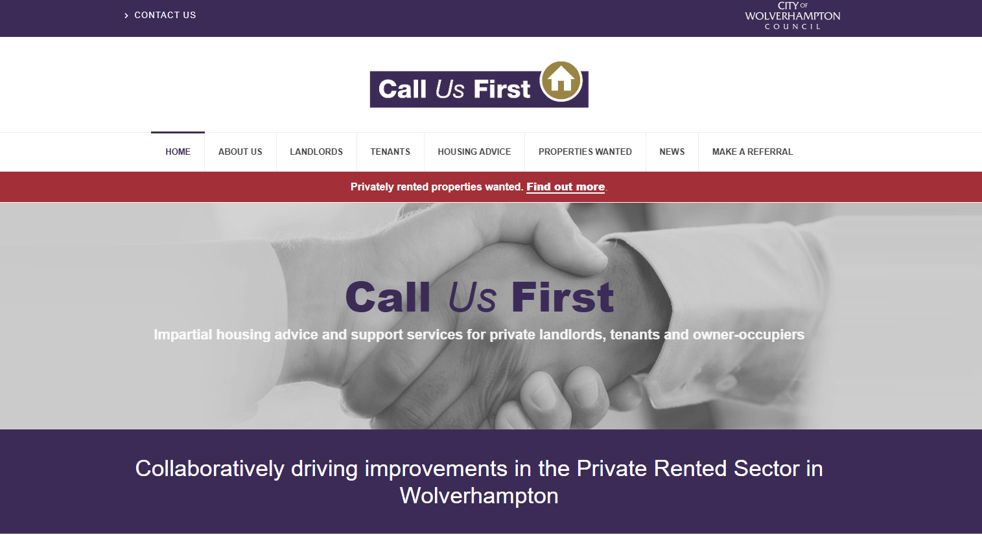
Key changes and improvements – cont.
‘Make a referral’ has been added to the headings which makes it easier for a landlord, tenant or professional to make a referral.
wolverhampton.gov.uk

Slide 5
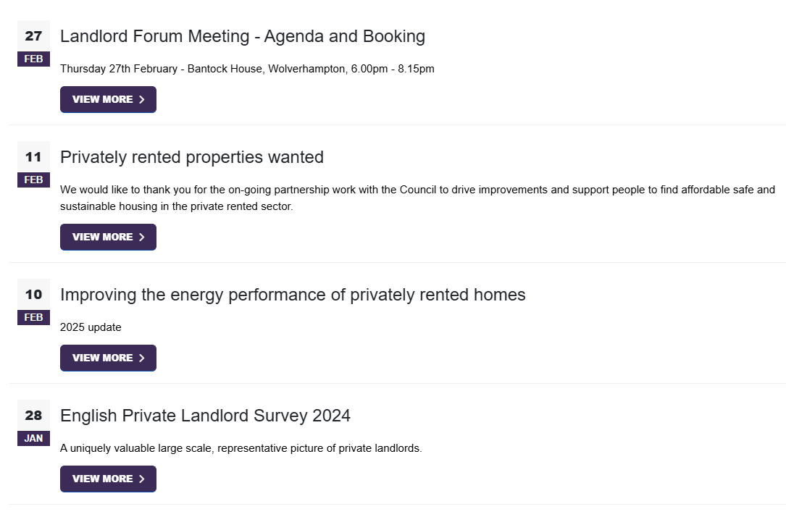
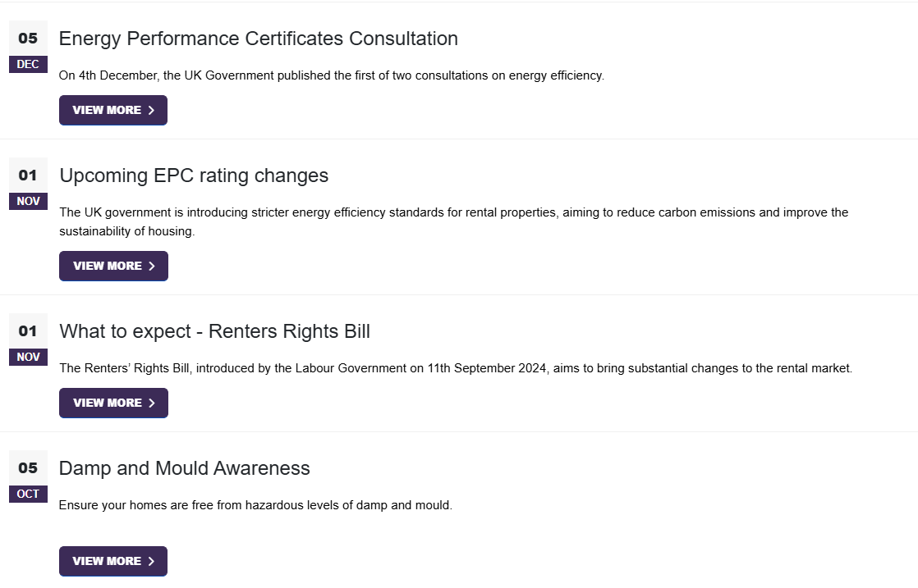
Key changes and improvements – cont.
A dedicated news page will be updated regularly with sector news and events:
wolverhampton.gov.uk

Slide 6
Key changes and improvements – cont.
All partner organisations have been added to each page, with a link to their dedicated website.
wolverhampton.gov.uk

Slide 7
Feedback
We welcome feedback to improve the site.
If you feel there could be improvements, from a landlord or tenant perspective then please send them to callusfirst@wolverhampton.gov.uk or Daniel.cartwright3@wolverhampton.gov.uk.
wolverhampton.gov.uk

Slide 8
wolverhampton.gov.uk

